Slide 1
Decision Tree
Entropy, GINI, and Model Evaluation
Akash Gawade

Slide 2
Introduction to Decision Trees
Definition:
A supervised ML algorithm for classification/regression.
Splits data into subsets based on feature values.
Structure:
Root Node (start), Internal Nodes (decisions), Leaf Nodes (outcomes).
Use Case:
Easy to interpret, handles non-linear data.

Slide 3
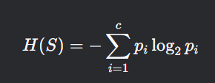
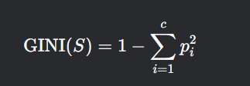
Key Concepts: Entropy and GINI
Entropy
(Slow)
GINI
(Fast)
Goal: Minimize impurity in splits.
Entropy:
Measures disorder (0 = pure, 1 = impure).
GINI Index:
Measures probability of misclassification (0 = pure, 0.5 = impure).

